Slide 1

CS6375 Machine Learning
Telecommunication Churn Prediction
By,
FNU Anuja (AXN220123)

Slide 2

Problem Statement
To create a predictive solution that empowers the company to allocate resources efficiently, enable the development of targeted retention strategies. The ultimate objective is to enhance customer satisfaction, loyalty, and long-term profitability in a competitive market.

Slide 3
Dataset details:
This dataset consists of customer activity data (features) as well as a churn label indicating whether a customer cancelled their subscription, will be used to develop predictive models.
This is a brief overview of this dataset:
A consumer is represented by each row, and the attributes for that customer are listed in each column.
The data collection contains the following information: Churn column(output) : Customers who left the service and the feature vectors(input)
Every user has signed up for a number of services, including phone, internet, multiple lines, online security, online backup, device protection, tech assistance, and streaming TV and films.
The amount of time a customer has been on the contract, the payment method, paperless billing, monthly charges, and total charges are all included in their account information.
The demographic details of the customers, including their age range, gender, and whether they have dependents or relationships

Slide 4
Variable details
Input Features:
Senior Citizen
Gender
Partner
Dependents
Tenure
Phone Service
Multiple Lines
Internet Service
Online Backup
Device Protection
Tech Support
Streaming TV
Streaming Movies
Contract
Paperless Billing
Payment Method
Monthly Charges
Output feature:
Churn – Yes/No

Slide 5
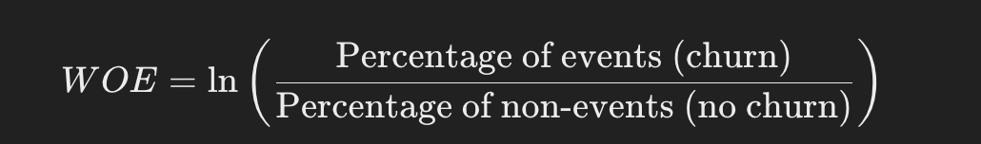
WOE (Weight of evidence)
The telecom churn analysis, includes Information Value (IV) and Weight of Evidence (WOE). Weight of Evidence (WOE) WOE is a metric used in logistic regression and other predictive modeling to evaluate the link between a target variable (like customer loss) and a variable that is predictive (like internet service type). It measures a category's predictive power in relation to the population as a whole.
Positive WOE: The category is positively associated with churn (higher churn rate).
Negative WOE: The category is negatively associated with churn (lower churn rate).
WOE close to zero: The category has a churn rate similar to the overall average.

Slide 6
Information value (iv)
IV measures the predictive strength of a variable for distinguishing between churned and non-churned customers.
Thresholds for IV:
If IV > 0.1 means strong predictor
If IV is between 0.05 and 0.1, it is moderate predictor
If IV< 0.05, it is weak predictor

Slide 7

Bivariate Analysis:
Bivariate analysis means the analysis of bivariate data. It is one of the simplest forms of statistical analysis, used to find out if there is a relationship between two sets of values. It usually involves the variables X and Y. The results from bivariate analysis can be stored in a two-column data table.

Slide 8
Analysis
When churn rate is low, the separation is poor, and it is an ineffective variable for prediction. When churn rate is good it can be taken for model prediction.
In the above-mentioned features Gender, phone services and multiples lines appear to have low effect on churn rate.
The orange line indicates the churn rate, and green column represents the population percentage.
Below are the analysis snapshots of other feature vectors which have good churn rate.

Slide 9

Example
Interpretation of Categories:
No TechSupport:
Makes up 49.31% of the population.
Has the highest churn rate at 42%.
No Internet Service:
Comprises 21.67% of the population.
Has the lowest churn rate at 7%.
Yes, to TechSupport:
Covers 29.02% of the population.
Has a relatively low churn rate at 15%.
Insights:
Customers without TechSupport are much more likely to churn compared to those who have TechSupport.
A lack of internet service correlates with a significantly lower churn rate, which might be expected as these customers are not fully engaged with the company's offerings.

Slide 10
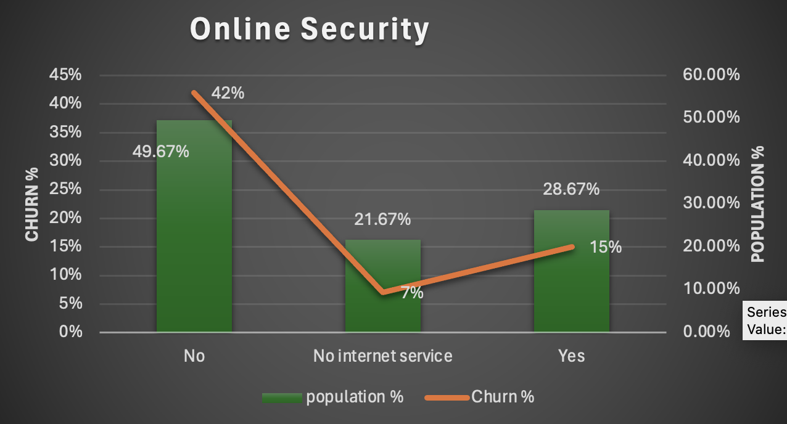
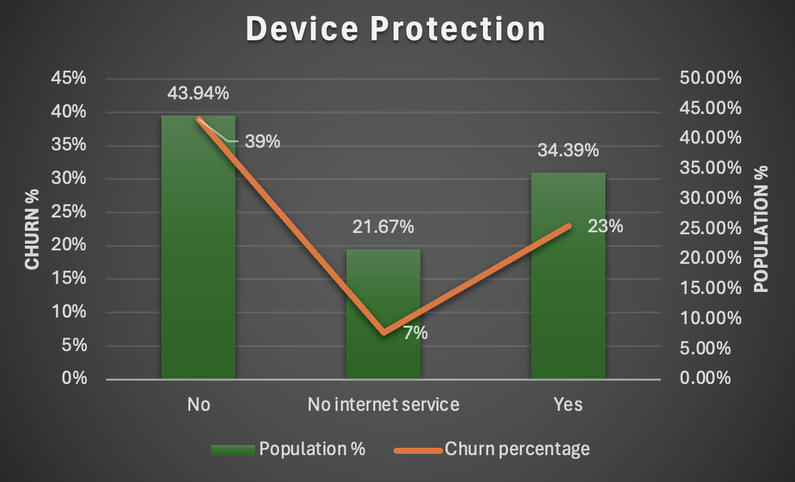
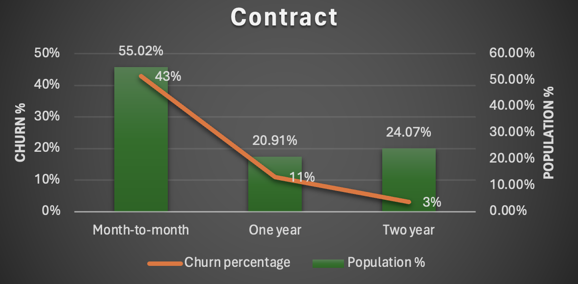
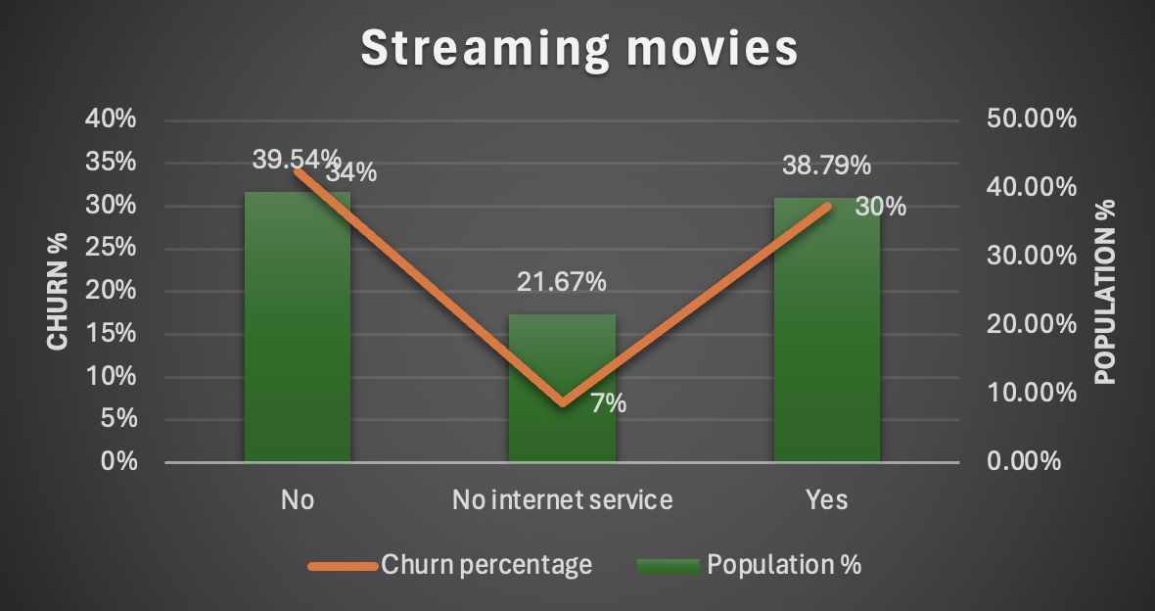
Input features and bivariate
Here we are finding relationship between population and churn rate.

Slide 11
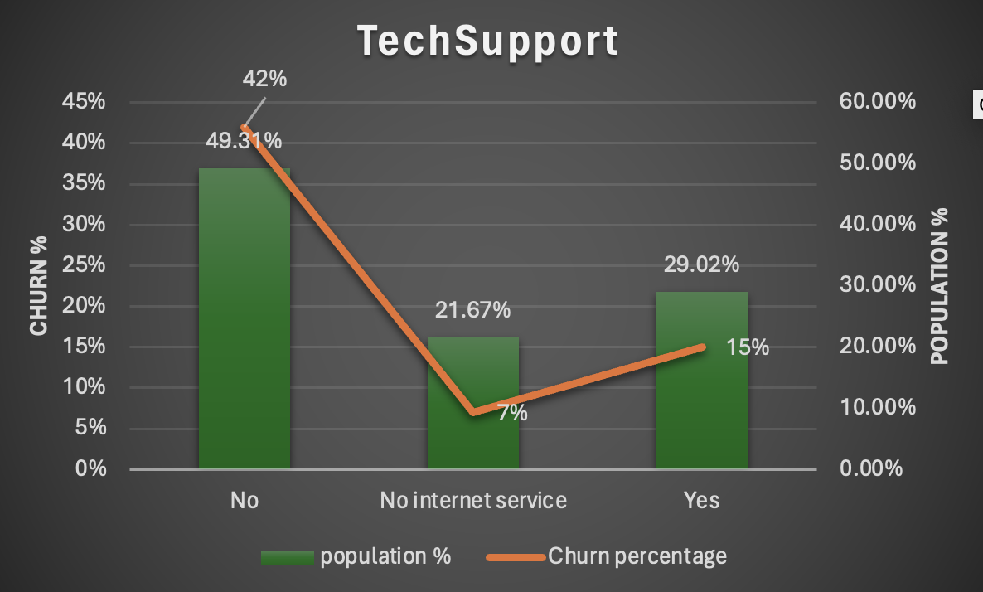
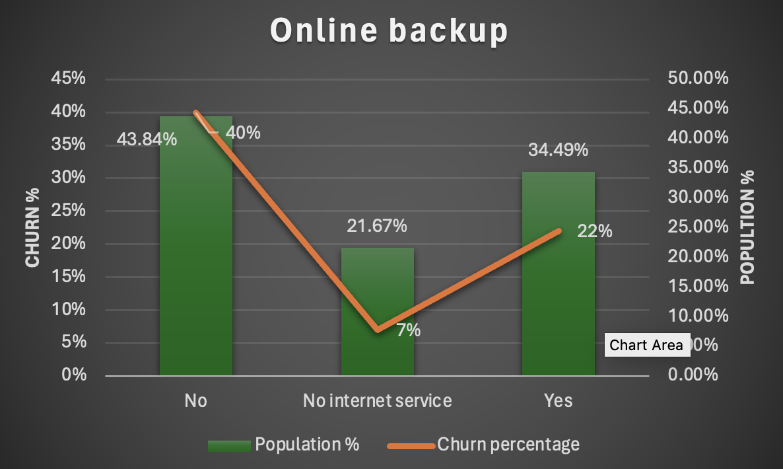
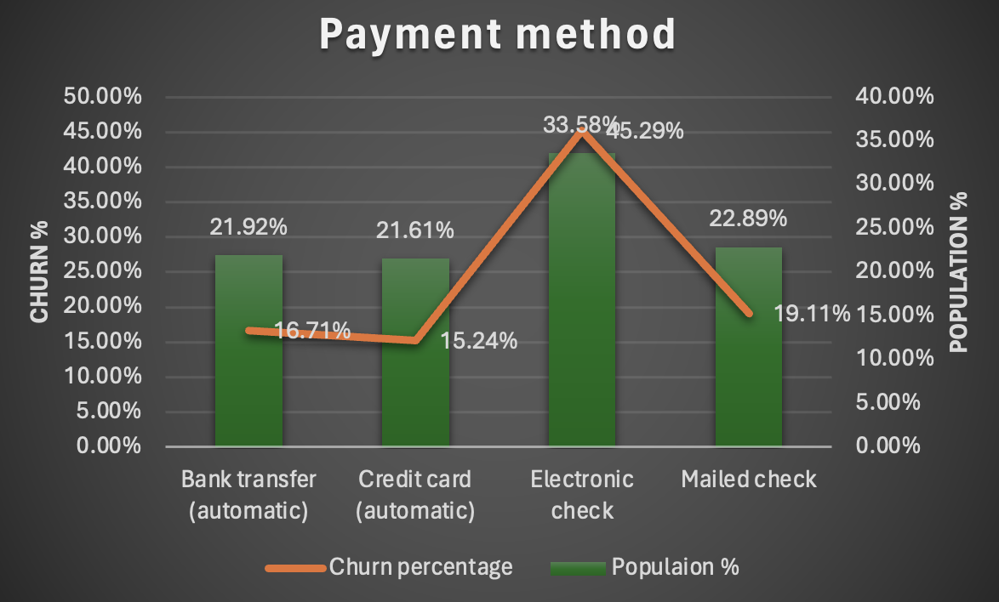
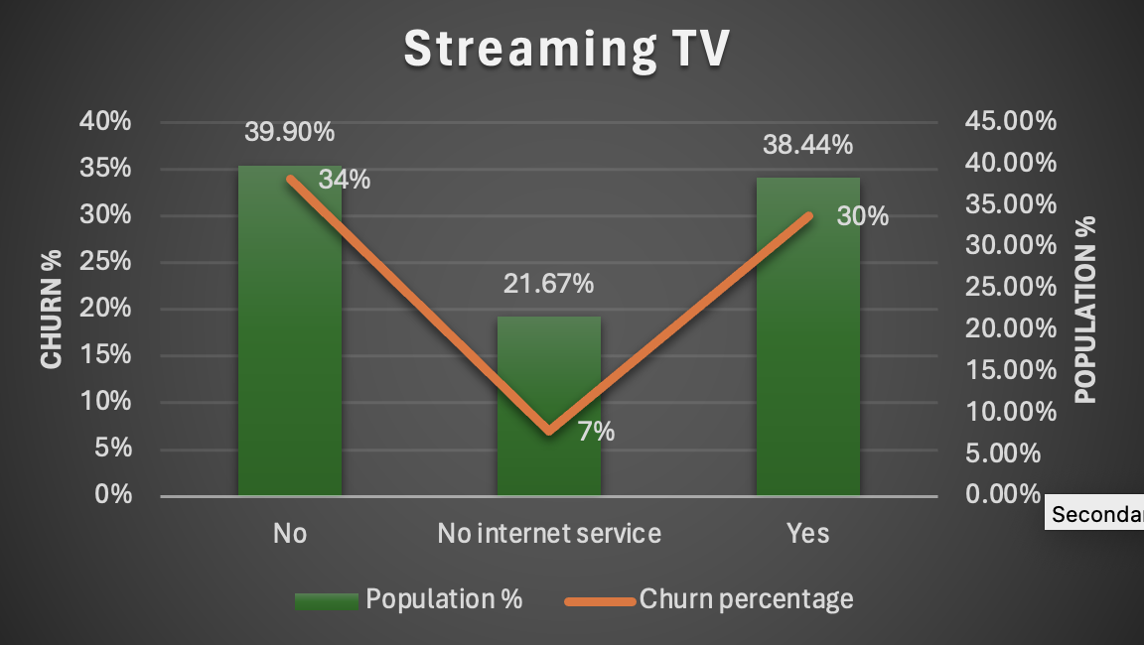
Input Features and bivariate

Slide 12
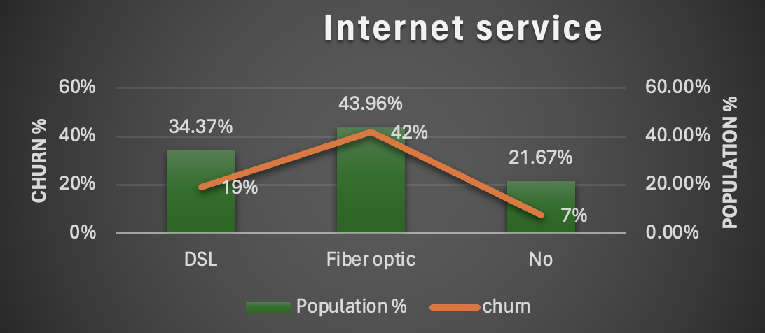
INPUT FEATURES AND BIVARIATE
In Fibre optics, it represents the largest portion of the population at 43.96%. It has the highest churn rate at 42%, suggesting dissatisfaction or competitive alternatives. which may be a sign of problems like poor service or unsatisfactory prices.
Significantly lower churn among DSL consumers may be due to greater satisfaction or fewer choices.
Due to less service encounters, customers without internet service are the least likely to churn.

Slide 13
Algorithms:
Logistic regression.
Random forest.
Support vector machines.
Decision tree RPART model.
Why logistic regression over others:
Logistic Regression is a simple linear model that assumes a direct relationship between features and the log-odds of the target variable (churn in this case). Algorithms like Decision Trees or Random Forests can overfit small datasets if not properly tuned. It is less prone to overfitting because it regularizes the relationship (especially with penalties like L1 or L2 regularization).

Slide 14
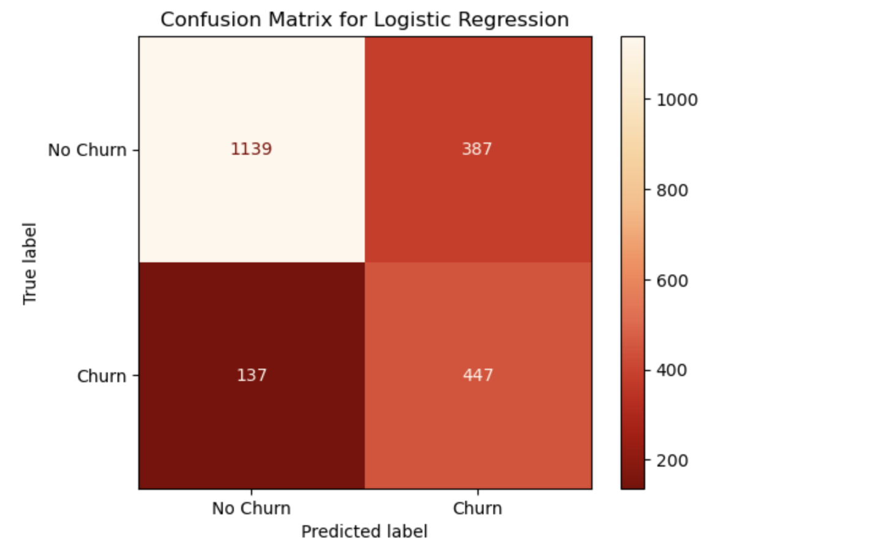
Experiments:
1. True Negatives (TN) (Top Left: 1139)
The model correctly predicted No Churn when the actual label was No Churn.
These are correct rejections.
2. False Positives (FP) (Top Right: 387)
The model predicted Churn when the actual label was No Churn.
These are Type I errors, indicating the cost of incorrectly targeting non-churning customers.
3. False Negatives (FN) (Bottom Left: 137)
The model predicted No Churn when the actual label was Churn.
These are Type II errors, indicating the cost of missing actual churners.
4. True Positives (TP) (Bottom Right: 447)
The model correctly predicted Churn when the actual label was Churn.
These are correct detections.

Slide 15
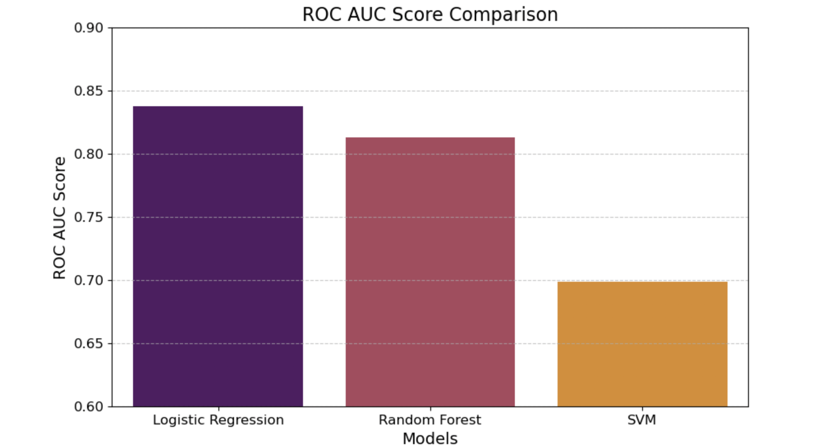
Comparison
Three models Logistic Regression, Random Forest, and SVM that are used to forecast customer attrition in the provided dataset are compared using a bar plot. The model's capacity to differentiate between churn and non-churn clients is measured by the ROC AUC score. A higher number indicates better performance. Logistic Regression achieves the highest ROC AUC score, around 0.83 indicates strong predictive performance in distinguishing between churn and no-churn.

Slide 16
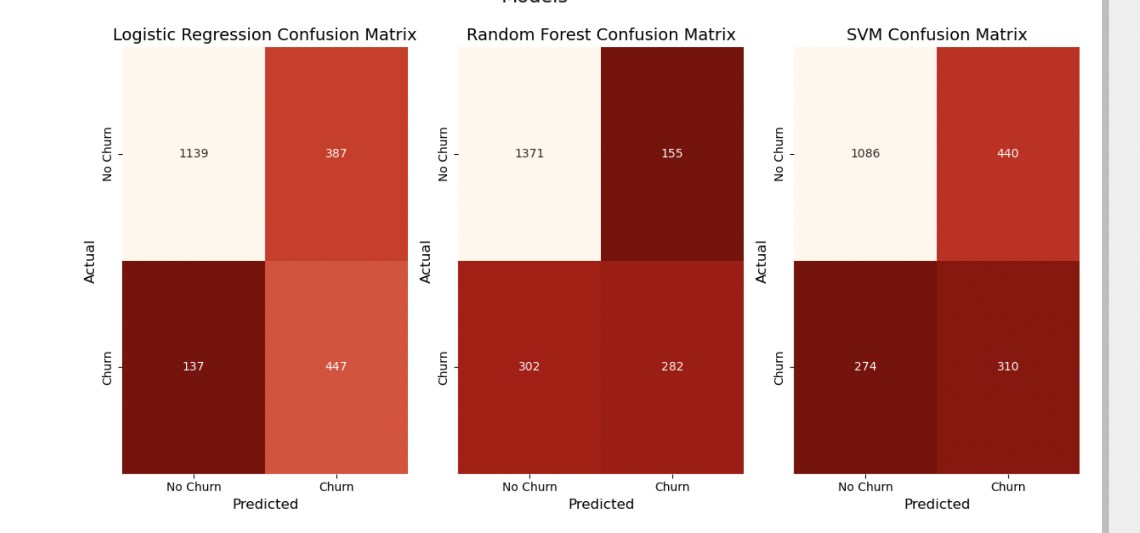
Confusion matrix of all three

Slide 17
decision TREE (RPART) MODEL

Slide 18
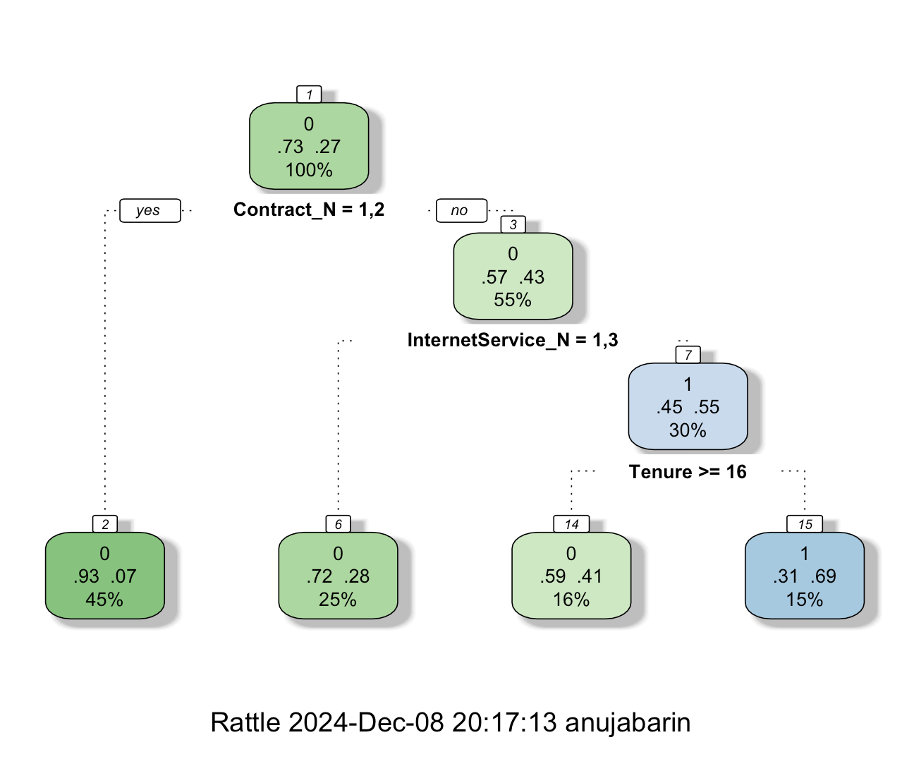

Slide 19
Derived variable Contract_N:
1 denotes Contract for a Year
2 denotes a two-year contract.
3 denotes a monthly contract
Derived variable Internet Service:
1= DSL
2= fibre optics
3= No Internet Service
Interpretation of the model
Population percentage is 15%, and churn rate is 69% for samples with Contract = 3 [monthly contract] & Internet Service = 2, i.e. Fibre Optics & Tenure less than 16.
The population with yearly and two-year contracts, Contracts N 1 and 2, have the lowest churn rate. In this case, the demographic data shows a 45% churn rate of 7%.

Slide 20
Conclusion
Machine learning was effectively used in the Telcom Churn Prediction project to forecast customer attrition and pinpoint the main causes of it. With a high ROC-AUC score (~0.83), Logistic Regression was the most successful model, followed by Random Forest. It showed that while value-added services like online security greatly decreased the chance of customer loss, clients with shorter tenure, monthly contracts, or electronic cheque payments were more likely to churn. The telecom company can use these results to create focused retention efforts, like encouraging long-term agreements, combining services, and providing targeted outreach to high-risk clients. The initiative offers a strong basis for data-driven decision-making to increase customer loyalty and lower attrition rates, even several drawbacks.

Slide 21
Video is included in next slide:
Video includes explanation of ppt, dataset and code part.

Slide 22

Thank you

